Slide 1
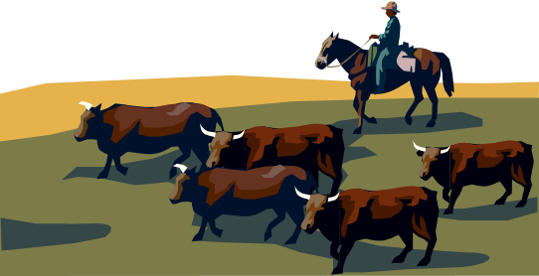
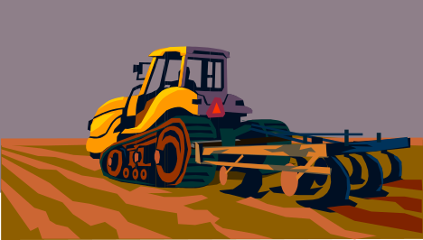
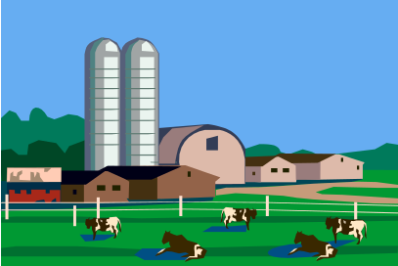
Introduction to Starting an Ag/Hort Business
AREC 213
Notes:
In 2006, nearly 650,000 businesses were started in the US.
More than 550,000 closed.
This class is intended to improve your chances for success in launching a new business enterprise.

Slide 2
Starting a Business
Business Planning Format
  Thought Process
  Structure
Unit = Business Plan Section
  SBA.gov
Practical Microbusiness Focus
Agriculture/Horticulture Examples
Syllabus

Slide 3

Learning Objectives
Business Planning Process
Business Management Skills
Assess the Viability of a New Business Idea
Set Expectations for What it Takes to Start a Business
Syllabus

Slide 4

Why Ag/Hort Businesses?
Student Interest
Entry points and Scalable
Special considerations
Basic Business Management Techniques and Skills Transferable
Syllabus

Slide 5







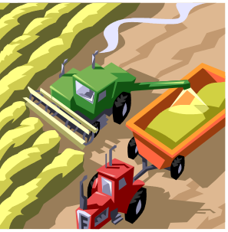

Example Ag/Hort Businesses
Seasonal Specialties
Processed Foods
Farm Equip Detailing
Extended Season Produce
Agritourism/Agritainment
“Heritage” Products
Landscape Maintenance
Custom Crop Harvesting
Roadside Stands
Syllabus

Slide 6
Format
Monday
  Review Homework Assignment
  Lecture on New Business Plan Topic
Wednesday
  Continue Lecture on New Business Plan Topic
  Quiz on Previous Business Plan Topics
  Work on Business Plan
    On-line Research
    In-Class Consulting
  Group discussion on SBA Business Plan
    General Ideas
    Homework Assignment for Monday
Syllabus

Slide 7

Grading
Business Plan – 40%
  20 pts Content
    One chapter/week
  20 pts Presentation
    Spelling, formatting, visuals
Quizzes – 15%
Participation – 25%
  On-Time Attendance
  Class Contributions
Business Plan Presentation – 20%
Syllabus

Slide 8
Business Plan Document
One New Chapter of Plan Each Week
Microsoft Word Format
Submit in Class on Monday
Can Revise for Credit until Last Chapter Due Date
  Must use “Track Changes”
Syllabus

Slide 9

Class Texts
No Required Text
Two excellent references (posted):
  How to Start a Business in Oregon
    BRCGUI1100
    ~50 pages
  Employer’s Guide for Doing Business in Oregon
    BRCGUI1103
    ~60 pages
Syllabus

Slide 10
Class Schedule
Week
Topics
1 Intro to Business Planning
2 Business Description
3 Market & Opportunity Assessment
4 Product/Service Description
5 Marketing & Sales Plans
6 Operations Plans
7 Management & Employees
8 Leadership & Program Management
9 Financial Plan
10 Business Plan Presentations
No Final Exam
Syllabus

Slide 11
Introduction to Starting a Business
Notes:
In 2006, nearly 650,000 businesses were started in the US.
More than 550,000 closed.
This class is intended to improve your chances for success in launching a new business enterprise.

Slide 12
Outline
What is a Business
Do you Really Want to Run a Business
Evaluating your Capabilities
Business Value Chain
Business Plan
Value Proposition
Introduction

Slide 13
What is a Business?
Hobby
  Motivation is interest/enjoyment, not profit
  Expenses not deductible and income generally not taxed
Investment
  Motivated by long term financial gain
  Expenses reduce cost basis and profit taxed as capital gain
Business
  Intent to make money
  Deductible expenses and taxable income
  Can be part time
  Doesn’t have to be primary source of income
Introduction

Slide 14

What’s the Difference?
Hobby
  Makes no profit in three of five years in danger of being judged a hobby
Business
  Affairs of the activity are conducted in a businesslike manner – accounting & records
  Separated from personal affairs
Introduction
Notes:
Is your interest in running a business or do you have a very active hobby?
Investing is different than running a business

Slide 15

What is a Small Business?
Independently owned and managed venture that does not dominate its market
Less than 500 employees
  86% have less than 20!
Generally have revenues less than $1M
Introduction
Source: Small Business Administration

Slide 16
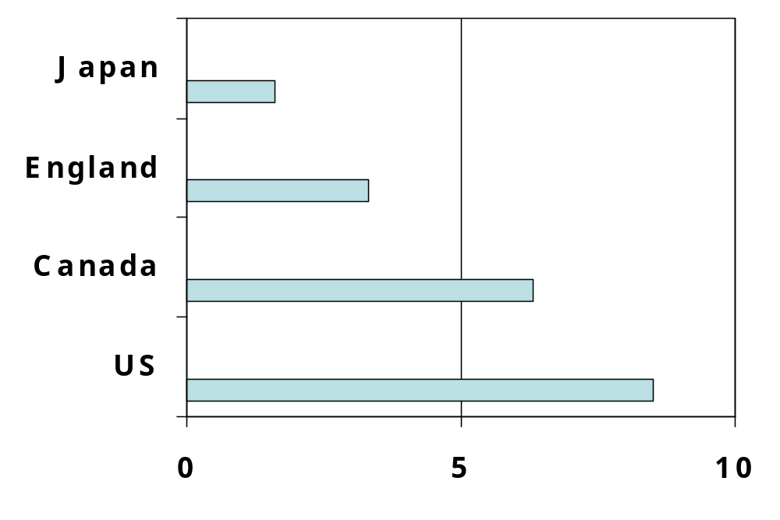
Starting Businesses
Percent of Adults Starting a Business
1 in 12 people
A new business is born every 11 seconds in the United States
Introduction

Slide 17
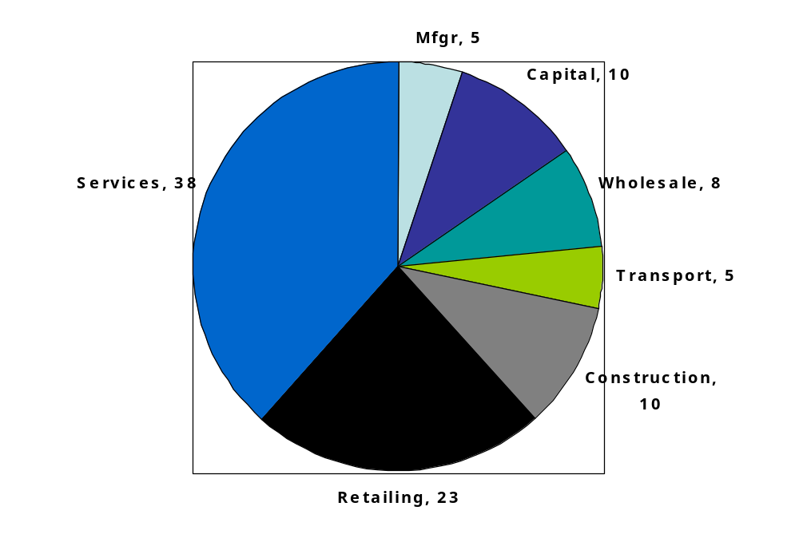
Starting Businesses
Types of Business
Introduction

Slide 18

Survival Rates
Common Knowledge???
  Starting a business is a huge gamble
  50% fail in one year
  95% fail in five years
Reality!!!
  67% survive first two years
  44% survive at least four years
  37% survive at least six years
  Starting a business is a calculated risk
Introduction
Source: Small Business Administration

Slide 19

Who Starts a Business?
Age at Start-Up
25-34 71%
18-24 years 8%
35-44 13%
45-54 6%
55+ 2%
Introduction
Source: Small Business Administration

Slide 20

Work Load
Common Knowledge???
  Starting a business requires longer/harder work
Reality!!!
  8% work less than 40 hrs
  25% work more than 70 hrs
  Average is 64 hours/week (first two years)
  84% of entrepreneurs polled love the type of work they do!
Introduction
Source: Small Business Administration

Slide 21

Earnings
Wishful Thinking….
  I can live off the business immediately
  I’ll get rich overnight
Reality!!!
  “Lemons ripen in 2 ½ years, pearls take 7 or 8 years
  20% of millionaires started and run private business
Introduction

Slide 22
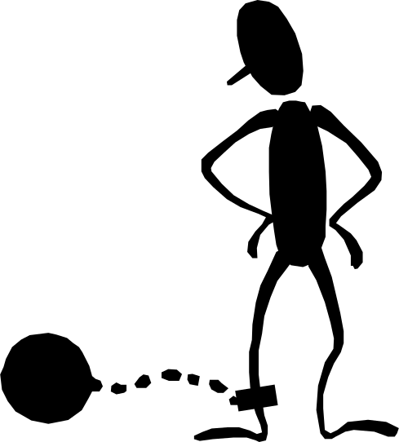
Independence
Wishful Thinking….
  I’ll be my own boss
  I can be independent
Reality!!!!
  Business owners are far from independent; they serve many masters – partners, investors, customers, suppliers, creditors, employees…
Introduction

Slide 23
Successful Business Owner Traits
Creative
Intuitive
Motivation
To Excel
Ambitious
Self-Starters
Tolerant of
Risk & Uncertainty
Successful
Business
Owners
Adaptability
Optimistic
Disciplined
Methodical
Communication
Skills
Lifelong
Learners
Introduction

Slide 24
Businesses Fail Because:
Inadequate
Financing or Control
Lack of
Experience
Poor Planning
and/or Strategy
Inappropriate
Location
Small
Business
Failure
Insufficient
Commitment
Uncontrolled
Growth
Ethical
Failure
Incompetence
Lack of Skills
Introduction

Slide 25





Evaluate your Capabilities
Personal
Characteristics
Family
Support
Business
Skills
Financial
Resources
Introduction
Notes:
List comes from several venture capitalists which with I work.

Slide 26
Are you an Entrepreneur?
Are you a self starter?
Get along with different personalities?
Good at making decisions?
Stamina?
Are you a planner/organizer?
Do you have the drive/ambition?
Introduction

Slide 27
Business Types
Producer
Post Production/Finisher
Wholesaler
Retailer
Service
Franchise
Introduction

Slide 28
Business Value Chain
Producer
Wholesaler
Retailer
Consumer
Service/Support
Introduction
Notes:
Important to recognize where your venture falls within the business value chain.
Called value chain because with each transfer, value is added, typically 40%. So, a wholesaler typically marks up raw product by 20-40%; retailer marks up wholesale stock by 40-50% reflecting the value of storefront. So, what does a corn farmer get per pound vs frozen, packaged corn in the freezer aisle of your grocer?
Vertical Integration: control of more of the raw inputs
Cutting out the Middle Man: collapsing the value chain
Requirements/structure of a business will vary depending on placement.

Slide 29
Producer Business
Produces goods for sale in large quantities for sale to wholesalers
Fewer transactions of larger amounts
Primary value(s)
  Price
  Product
  Availability
Right Product, Right Price, Right Time
Introduction

Slide 30

Wholesale Business
Offers goods for sale in large quantities and/or minimum sale amounts to retailers or large customers
Fewer transactions of larger amounts
Primary value(s)
  Price
  Availability
Right Product, Right Price, Right Time
Introduction
Notes:
The primary contribution of the wholesaler is buffering the supply and demand equation over time.

Slide 31

Retail Business
Offers goods for sale in consumer quantities
Many transactions of modest amounts
Primary value(s)
  Location, location, location
  Availability
  Price
Right Place, Right Price, Right Product
Introduction
Notes:
Study after study shows that the primary factor differentiating success from failure in retail is location. Do you have the traffic to support your idea?
If not, you may end up spending much more in marketing/sales in order to generate traffic. It is much easier to take advantage of traffic than to generate it!
Example: coffee shops

Slide 32

Service Business
Offers labor services, expertise, and/or unique equipment to wide range of customers
Wide variety of transactions amounts
Primary value(s)
  Unique Process/Equipment
  Expertise
  Price
Right Person at Right Price
Introduction

Slide 33
Spotting Opportunities
Lifestyle and
Taste Changes
Government
Rules Changes
Demographic
Changes
BUSINESS
OPPORTUNITY!!
Economic
Dislocations
Technological
Advances
Calamities
Introduction

Slide 34



Getting Started in Business
Buy an Existing
Business
Buy a
Franchise
Start from Scratch
Introduction

Slide 35


Buy an Existing Business
Customer Base
Location
Business Systems in Place
Customer Losses
Dependencies on Previous Owner
Collections of Outstanding Receivables
Introduction

Slide 36
Franchise Business
Contractual arrangement to use trademark in selling of goods/services
Franchisee economically dependent on franchisor integrated business system
Primary value(s)
  Product/Service Recognition
  Geographic Territory
Known and recognized product/service
Introduction

Slide 37




Franchise Business
Fastest Growing
Business Processes
Lower Failure Rate
Proven Business
Centralized Power
High Start-Up Costs
Restrictions
Share Profits
Market Saturation
Introduction

Slide 38

Starting Your Own Business
Control your Destiny
Recognition
Do what you Enjoy
Uncertainty of Income
Risk of Loss
Complete Responsibility
Introduction

Slide 39
Business Planning

Slide 40
What is a Business Plan?
Detailed, written description of your business, business processes, customers, and your market
Living document – continuous process of assessing business viability
Guide to your business future
Introduction

Slide 41


Plans are a Reflection
Value is in the process of development
Shows you thought seriously
Reflects the character of you and your business
Introduction

Slide 42

Why Bother?
Prioritizes activity, exposes pitfalls, anticipates problems
Establishes goals and provides basis for performance comparison
Is my business feasible?
Builds your commitment to your business
Attracts others to your business
Provides a road map
Introduction

Slide 43

When do you need one?
May be Required for…
Bank financing
Investment partners
Strategic alliances
Large contracts
Key employees
Mergers and/or acquisitions
Credibility for Your Business!
Introduction
Notes:
This particular organization is based on developmental order.

Slide 44
Business Plan
Stakeholder | Emphasis
You | Business Feasibility
Banker | Cashflow
Investor | Growth
Strategic Partner | Business Synergy
Large Customer | Stability, Service
Key Employees | Opportunity
Introduction
Notes:
This particular organization is based on developmental order.

Slide 45

Business Plan
No single “right” format
Concise and focused
Accurate
Brutally honest
Includes negatives as well as positives
Obsolete soon as it’s printed!
Introduction
Notes:
This particular organization is based on developmental order.

Slide 46

Business Plan
10 Steps
Executive Summary
Value Proposition
Company Description
Market Description & Opportunity Assessment
Product/Service Description
Competitive Assessment
Marketing & Sales Strategy
Operations
Management and Employees
Financial Summary
Introduction
Notes:
This particular organization is based on developmental order.

Slide 47
END OF LECTURE
REVIEW AND QUESTIONS
LET’S LOOK AT YOUR PLAN
www.sba.gov/business-plan
COMPLETE COVER PAGE
Company Name
Owner(s)
Contact Information
Introduction

Slide 48
Household Budget
What is a Budget?
  Quantify Your Income and Expenses
How do I Make a Budget?
  Make a List (Spreadsheet)
What Do I Do With My Budget?
  Revise as Needed
Make Your Household Budget
Syllabus

Slide 49
Introduction to Starting an Ag/Hort Business
AREC 213
Notes:
In 2006, nearly 650,000 businesses were started in the US.
More than 550,000 closed.
This class is intended to improve your chances for success in launching a new business enterprise.

Slide 50
Business Plan
10 Steps
Executive Summary
Value Proposition
Company Description
Market Description & Opportunity Assessment
Product/Service Description
Competitive Assessment
Marketing & Sales Strategy
Operations
Management and Employees
Financial Summary
Introduction
Notes:
This particular organization is based on developmental order.

Slide 51
Value Proposition
Your business idea in a nutshell
A clear statement of the tangible value/results your customers get from using your products/services
Answers why your business will succeed
Specific and compelling
Introduction
Notes:
30 second elevator speech to a stranger.
Grandmother should be able to understand the value proposition.

Slide 52
Mission Statement
A Short and Simple Statement
  Outlines an Organizations Purpose
Composed of Three Components:
  Key Market
    Target Client or Customer
  Contribution
    What Product/Service is Provided
  Distinction
    Uniqueness of Product/Service
Introduction
Notes:
30 second elevator speech to a stranger.
Grandmother should be able to understand the value proposition.

Slide 53

Value Proposition
Weak – “We offer training classes for a wide variety of areas.”
Strong – “We offer high vigor hybrid apple trees that yield 5% more than standard varieties.”
Introduction
Notes:
30 second elevator speech to a stranger.
Grandmother should be able to understand the value proposition.

Slide 54

Value Proposition
Example – Can you Guess?
“We provide a friendly, comfortable, well-located place offering a wide range of fresh, customized quality coffees, teas, and other beverages for the person who enjoys a good experience and a good beverage.”
Introduction
Notes:
30 second elevator speech to a stranger.
Grandmother should be able to understand the value proposition.

Slide 55
Your Value Proposition Contains:
What (your product or service)
To Whom (your customer)
Why (your competitive advantage)
Introduction
Notes:
30 second elevator speech to a stranger.
Grandmother should be able to understand the value proposition.

Slide 56




Value Proposition
Dimensions of Value
Innovative Offering
A better mousetrap
Features
Performance
Packaging
Introduction

Slide 57



Value Proposition
Dimensions of Value
Lower Cost
The same, for less
Introduction

Slide 58



Value Proposition
Dimensions of Value
Quality, Reliability
Best quality
Introduction

Slide 59



Value Proposition
Dimensions of Value
Customer Responsiveness
Customer is #1
Introduction

Slide 60

Value Proposition
Dimensions of Value
Unique Niche
  Location
  Customer Knowledge
  Specialized Know-How
Local is Better
Introduction

Slide 61
REVIEW AND DISCUSSION
Introduction
Notes:
30 second elevator speech to a stranger.
Grandmother should be able to understand the value proposition.

